Slide 1
Stop & Wait

Slide 2
Utopian Simplex Protocol
No errors, no frame losses
Fast receiver
Sender sends frames in a loop as fast as it can (limited by channel bandwidth)
No error control, no flow control

Slide 3
Stop & Wait – Ideal channel
Receiver sends an acknowledgement (ACK) frame when ready to receive next
Sender only sends after reception of ACK
This is flow control!
Only one frame in flight at a time
“XYZ in Flight”: An XYZ that has been sent, but not acknowledged.

Slide 4
Stop & Wait – Lossy Channel
Automatic Repeat reQuest (ARQ)
We add error control to recover from lost or broken frames
Receiver sends an ACK after frame received correctly
If no ACK received, sender will retransmit after timeout
What’s a good timeout value?

Slide 5
Normal Operation
Timeout length
Sender
Receiver
E
Time

Slide 6
Stop & Wait – Lossy Channel
What if the ACK gets lost?

Slide 7
The Issue of Lost ACKs
Timeout length
Sender
Lost ACK
Receiver
This is a retransmission, NOT a new frame.

Slide 8
Stop & Wait – Lossy Channel
Receivers must be able to distinguish between:
Retransmitted old frames
vs
New frames
In other words:
We need a method to detect duplicate frames (frames received more than once)

Slide 9
The Issue of Lost ACKs
Frame 1 timed out. This can be because it was received with an error, or because the ACK was lost. Sender doesn’t care about the cause, it just re-sends.
Timeout length
0
1
1
0
Sender
Receiver
0
1
1
0
This is now clearly identified as a duplicate, so we can ignore it.

Slide 10
Stop & Wait – Lossy Channel
Solution: Frame sequence numbers somewhere in the data link layer header
In Stop & Wait, we can never have more than 1 frame in flight, therefore 2 numbers needed
Sequence number space: 0 and 1
1 bit needed in the header

Slide 11
One-Bit Sliding Window
Bi-directional communication between devices
Each device uses Stop-and-Wait
ACKs are sent as part of data frames Technique called Piggybacking
What is the benefit of piggybacking?

Slide 12
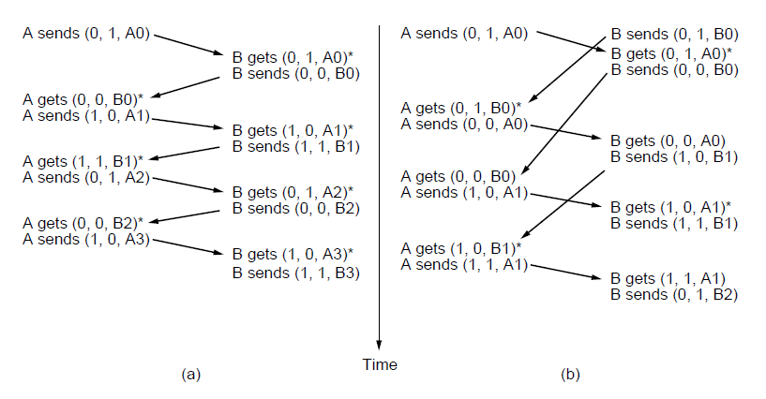
One-Bit Sliding Window Protocol
(a) Normal case. (b) Abnormal case. The notation is (seq, ack, packet number). An asterisk indicates where a network layer accepts a packet

